Slide 1
Data Science in Crime Predictions

Slide 2
Data Science vs Big Data
Data science: Data cleansing, preparation and analysis.
Excessive growth of data: 2.5 billion was generated everyday in 2012.
Big Data: Large volume of data and can be used to analyse problem insights and enhance decision making.

Slide 3
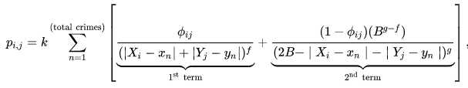
Prediction Software System and dedicated algorithms
Gower Cluster Algorithm (GCA): is a technique use for clustering data.
Rossmo’s formula: It is integrated into a specialised crime analysis software product called “Rigel”.

Slide 4
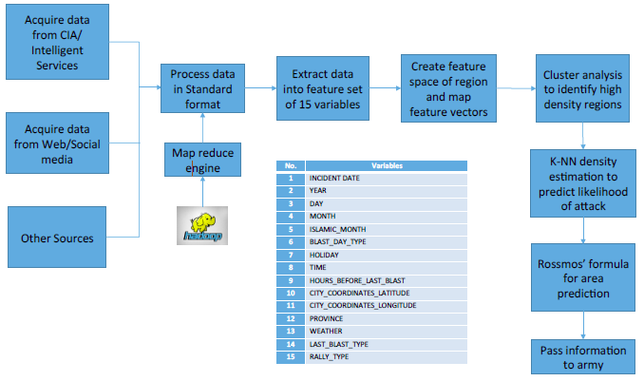
Prediction Software System Design and dedicated algorithms
The following figure depicts how data are processed using tool like Map Reduce engine and Hadoop for computing the information at hand.
Variables based on Islamism calendar activities type.

Slide 5
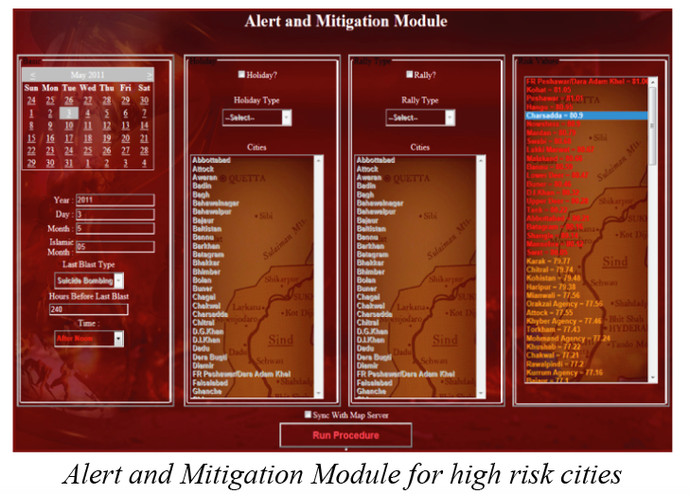
Prediction Software System Design and dedicated algorithms
By entering the 15 variables in the prediction software to be developed, the system will output the high risk localities in Baghdad which are vulnerable to possible future terrorist attacks.

Slide 6
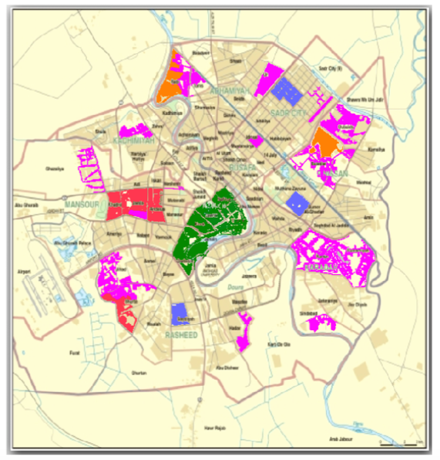
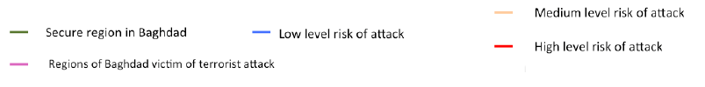
Prediction Software System Design and dedicated algorithms
According to Rossmo, if an attack happened at point B, it is likely that future attacks may happen at point A or C. Rossmo’s formula predicts the area vulnerable around previous attacked locations build on the GCA Algorithm.

Slide 7


Trends and Future expectations
India: Delhi police recently partnered with the ISRO to develop an analytical system – Crime mapping, Analytics & Predictive System (CMAPS).
China: Chinese government is working with the China Electronics Technology Group to develop technology similar to that used in the sci-fi thriller “Minority Report”. The objective is to predict acts of terrorism before they occur based on large amount of surveillance data.
Police in both Los Angeles and Manchester ran similar trials using a computer algorithm to predict where crime would take place (BBC iWonder post).
France: Anacrim and Salvac software were able solve many crimes in France.

Slide 8
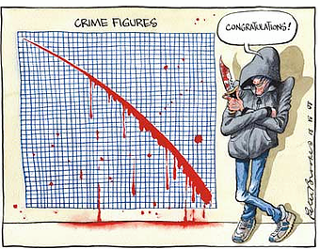
Thank you

Slide 9
References
Y. Zhiwen and W. Hau-San, "GCA: A real-time grid-based clustering algorithm for large data set", The 18th International Conference on Pattern Recognition (ICPR'06), no. 0-7695-2521-006, 2006.
Tom Lidbetter, ”A Game Theoretic Approach to Geographic Profiling For Soc Criminal Justice Special Interest Group”,: 2012.
Iraq crisis: Green Zone protests end in violence and curfew - BBC News [Internet]. BBC News. Available from: http://www.bbc.co.uk/news/world-middle-east-36344996

